Slide 1
ECE 313: PROBABILITY WITH ENGINEERING APPLICATIONS
Fall 2023
Prof. Eric Chitambar
Lecture 7

Slide 2
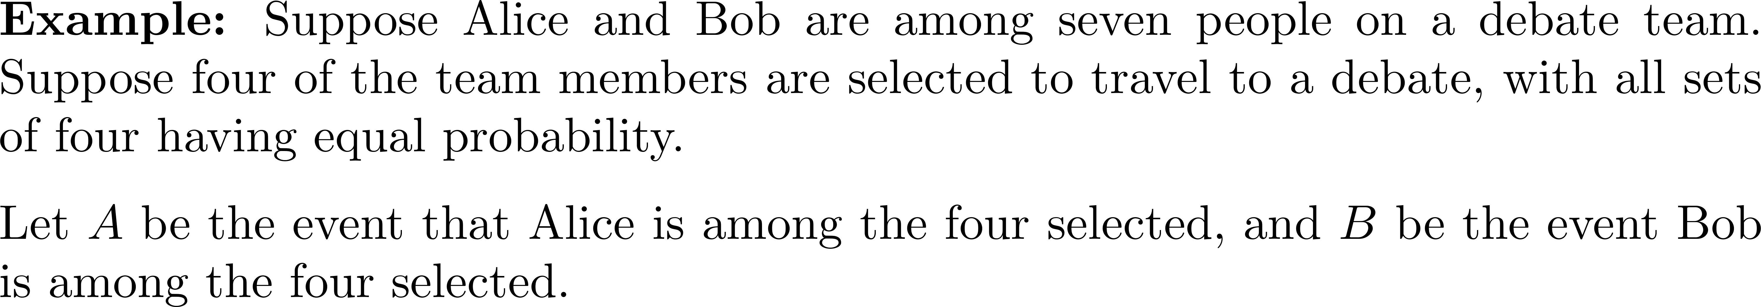



Conditional Probability

Slide 3
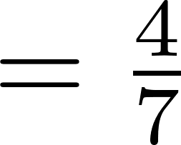
traveling
traveling
A
{6}
{5}
{4}
{3}
{2}
{1}
{6} | A | {5} | {4} | {3} | {2} | {1}
traveling
traveling
{6} | {5} | A | {4} | {3} | {2} | {1}
{6} | {5} | {4} | A | {3} | {2} | {1}

Slide 4



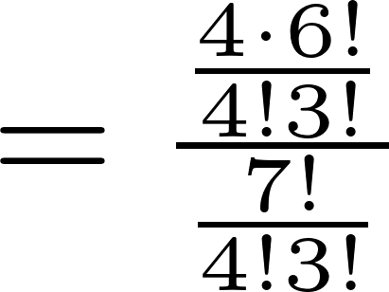
traveling
traveling
A | {6} | {5} | {4} | {3} | {2} | {1}
{6} | A | {5} | {4} | {3} | {2} | {1}
traveling
traveling
{6} | {5} | A | {4} | {3} | {2} | {1}
{6} | {5} | {4} | A | {3} | {2} | {1}
{7} | {6} | {5} | {4} | {3} | {2} | {1}

Slide 5





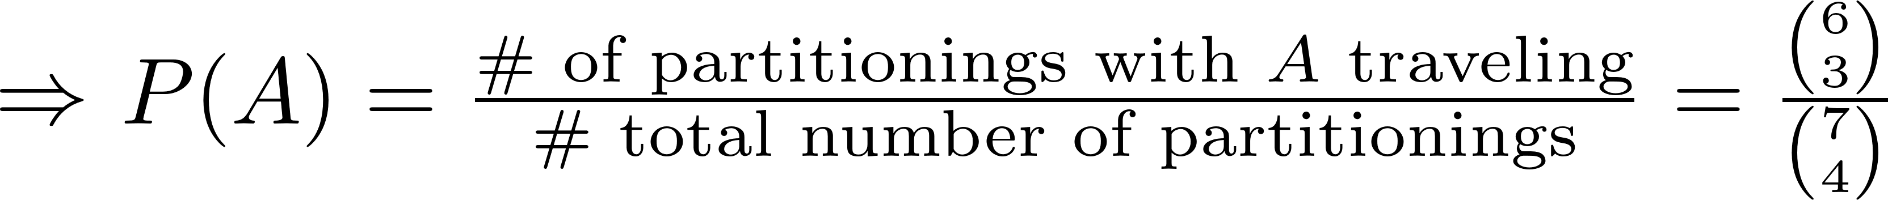
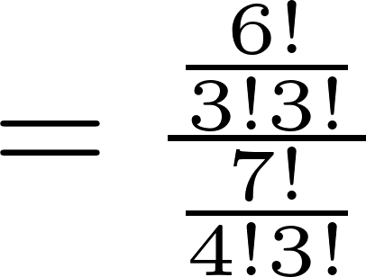
traveling
not traveling
traveling
not traveling

Slide 6
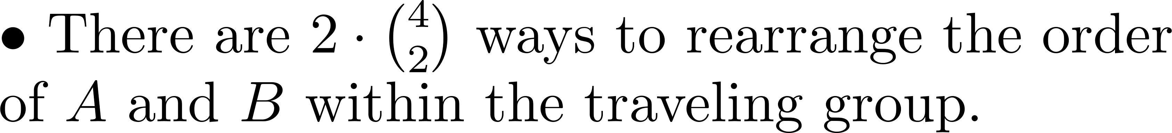


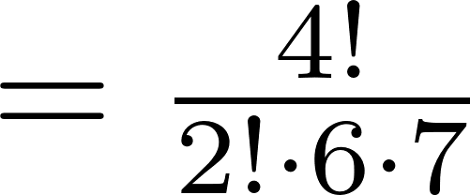
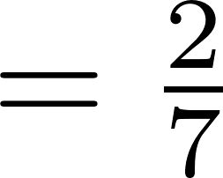



traveling
A | B | {5} | {4} | {3} | {2} | {1}
traveling
not traveling

Slide 7
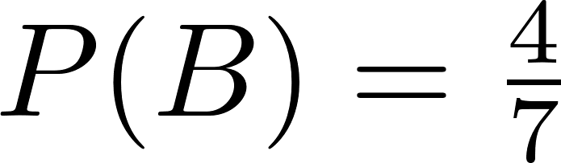
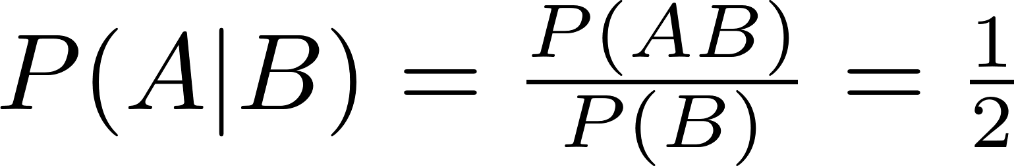
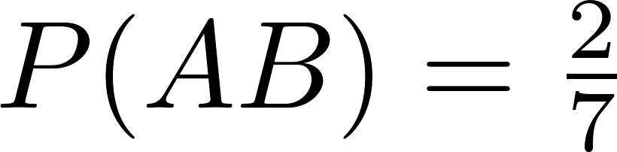
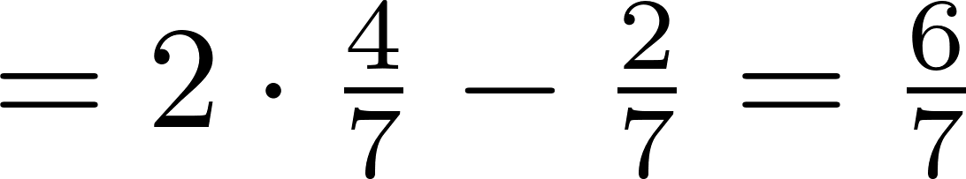


Slide 8
Conditional Probability and Independent Events

Slide 9
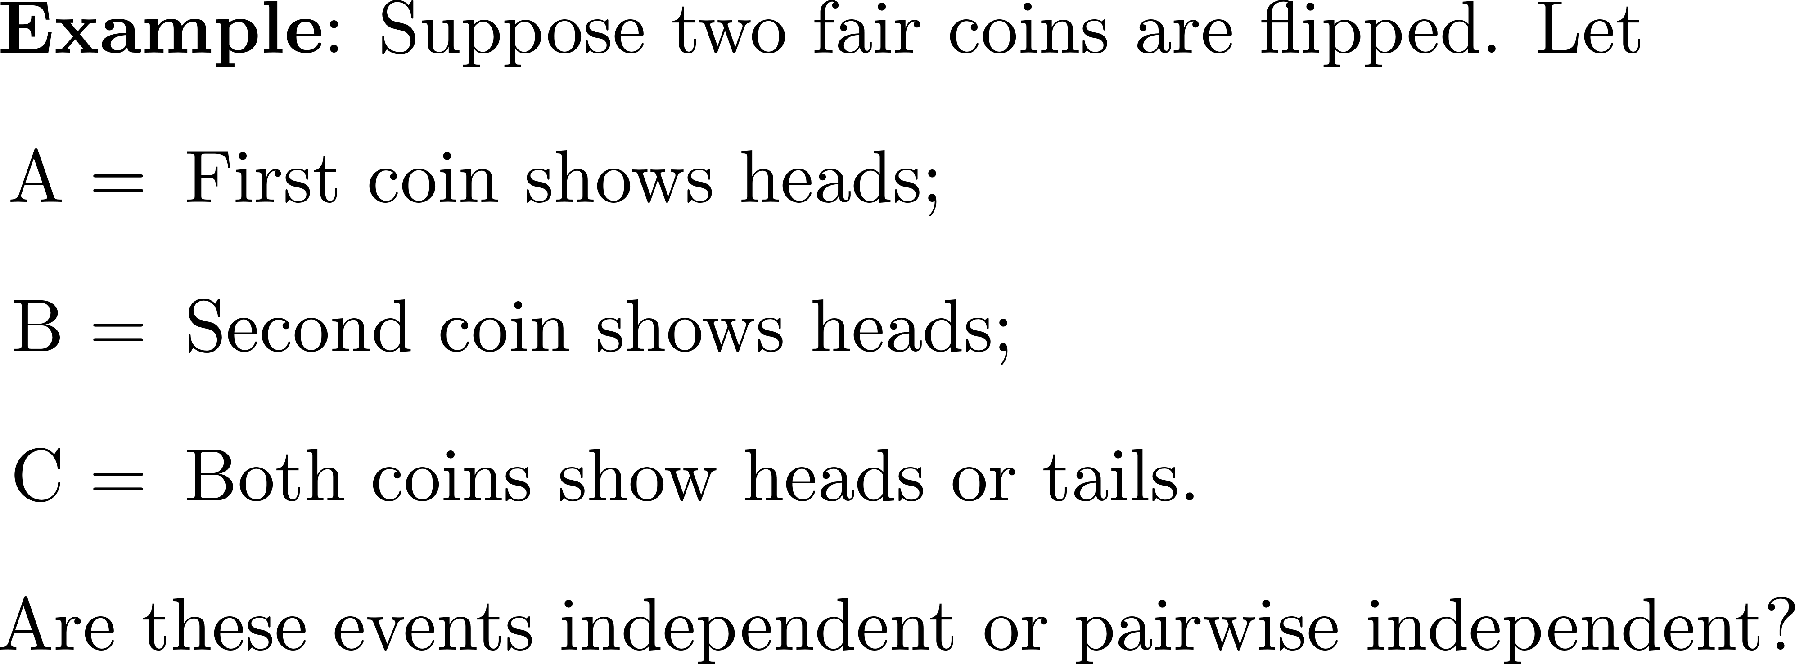
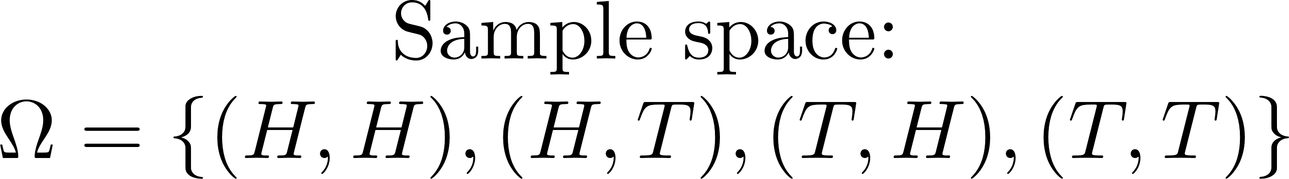

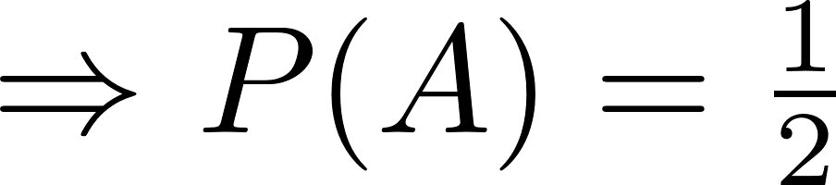

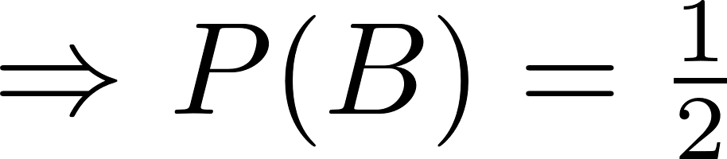

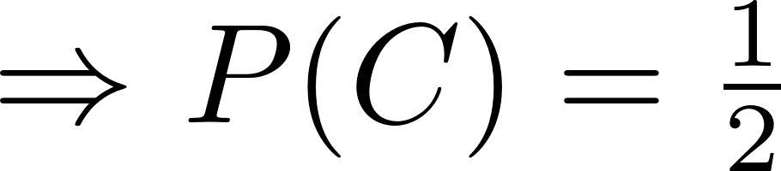
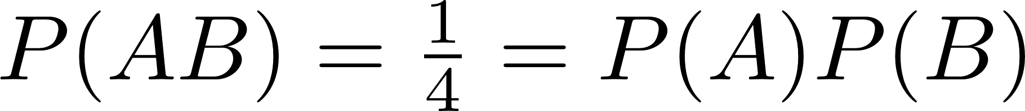



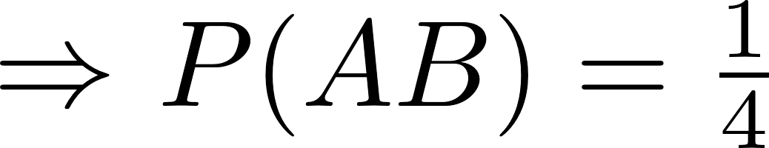
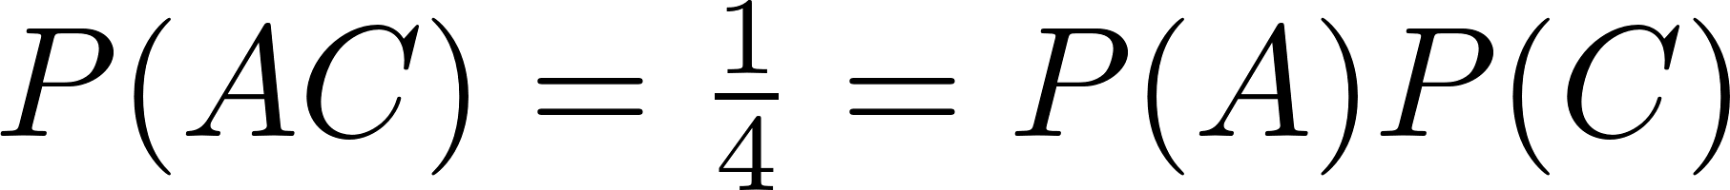


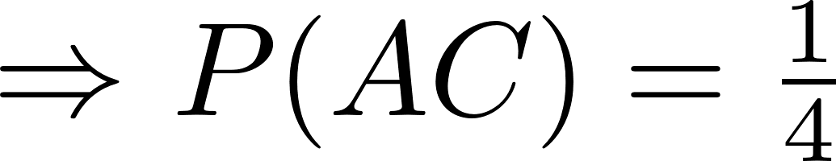

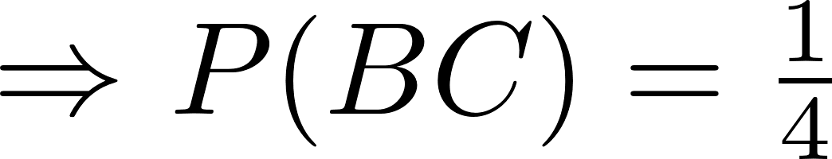
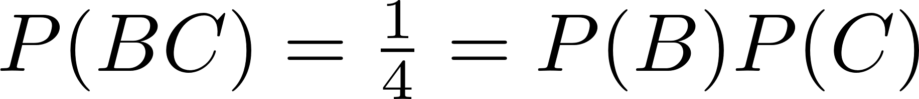


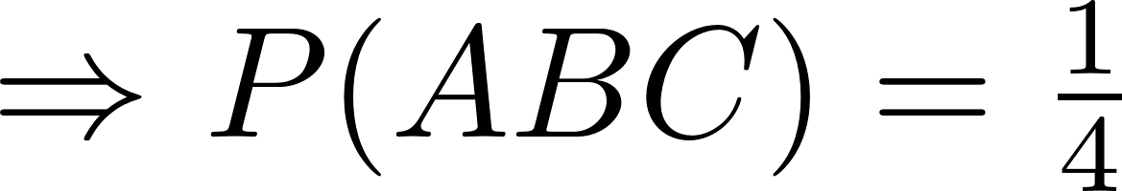
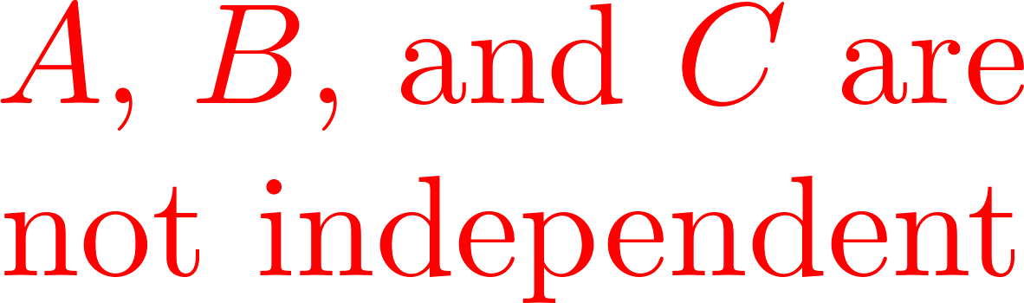
Conditional Probability and Independent Events

Slide 10
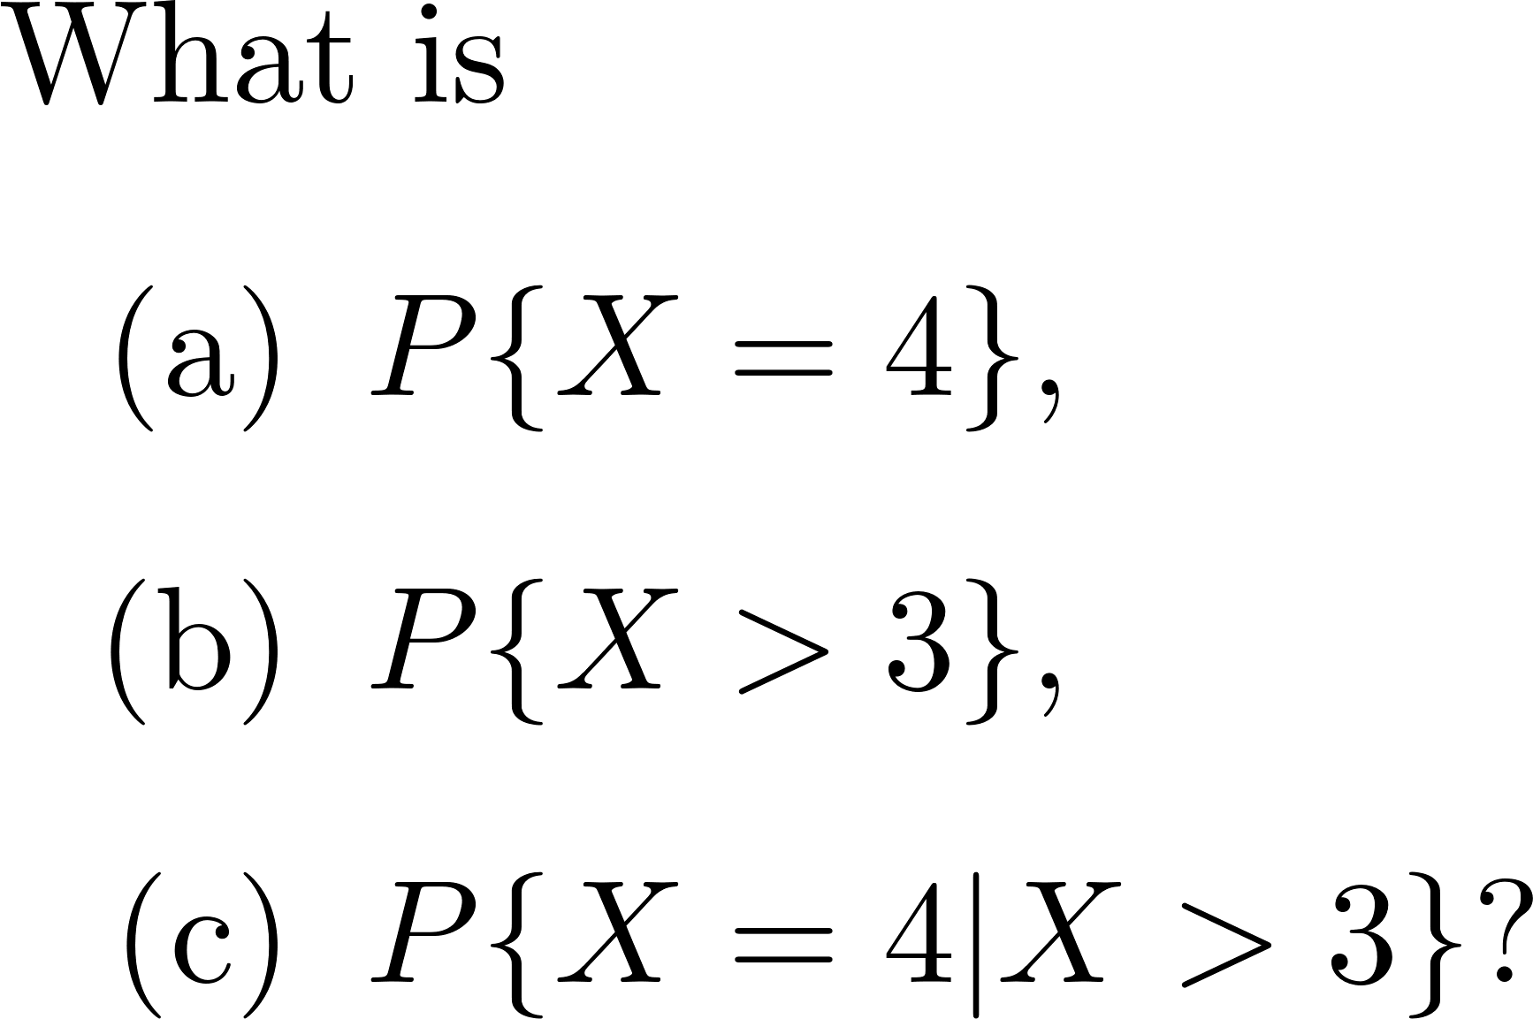
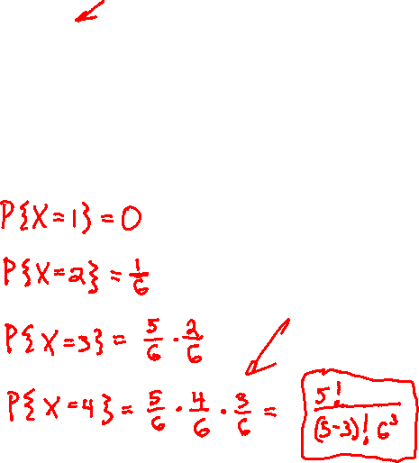
Independent Random Variables

Slide 11
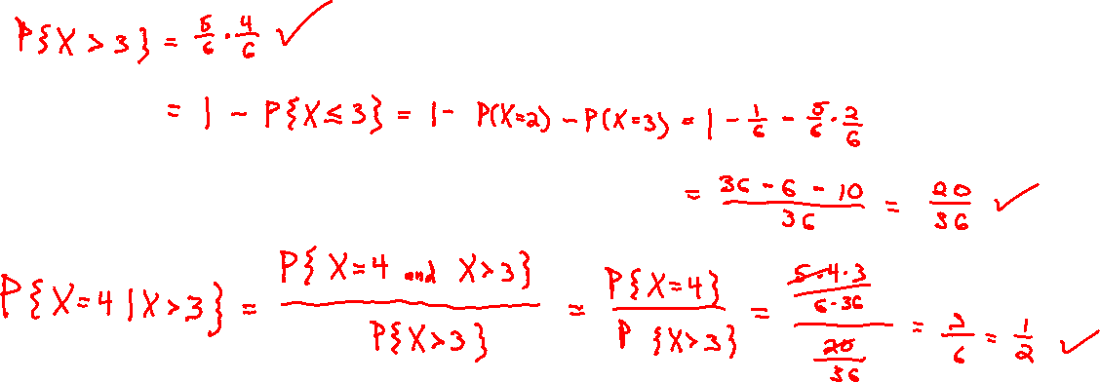

Slide 12
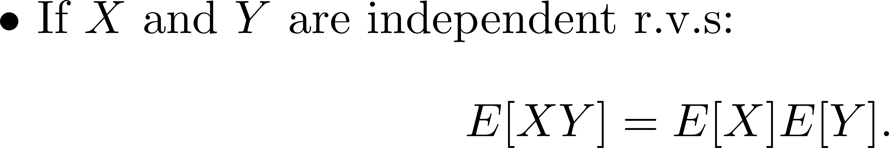
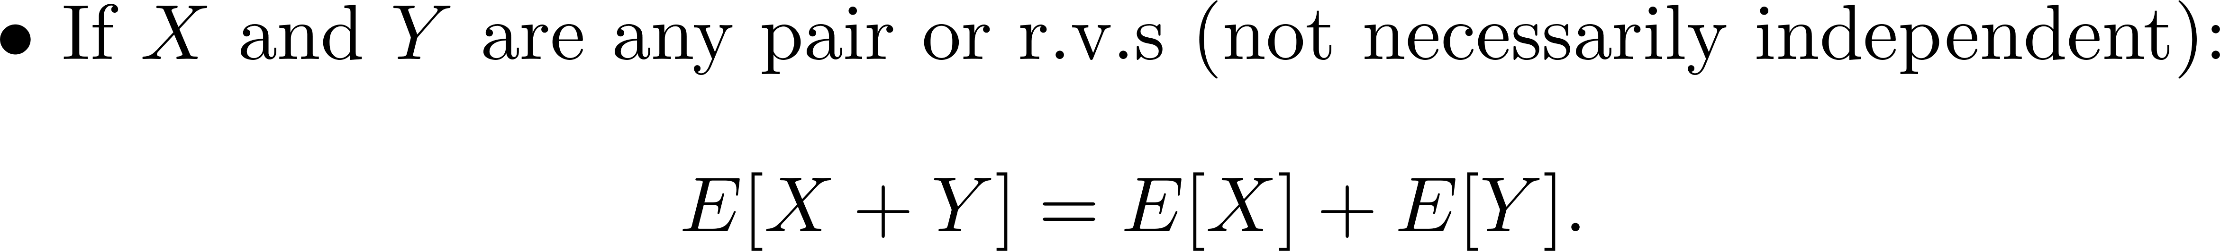
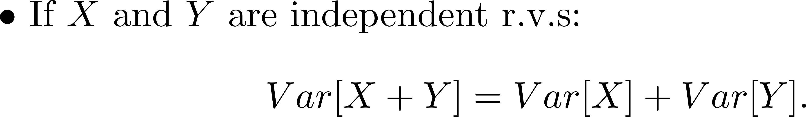
Independent Random Variables

Slide 13


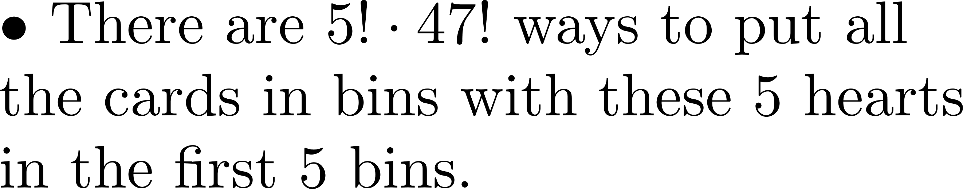
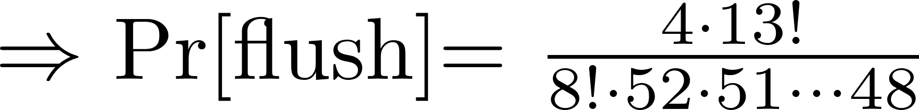

Poker Example
H₁ | H₂ | H₃ | H₄ | H₅ | {47} | {46} | … | {1}

Slide 14

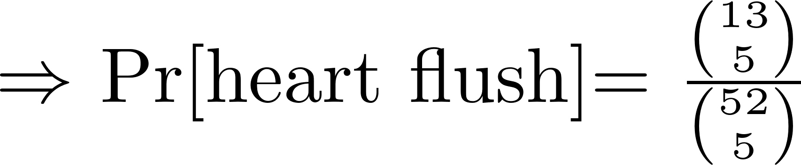
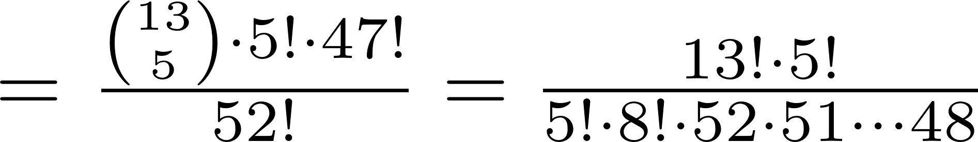
Poker Example

Slide 15
Poker Example

